Slide 1
Welcome To The
Notes:
Welcome and thank you for coming!

Slide 2
About Me
[Introduce yourself]
Why I became a vaccine advocate
Being part of a community means being part of a bigger whole. It means unifying on issues that matter to our community’s health. Immunity Community = UNITY.
It’s time that we all share our belief that vaccination is a safe and healthy choice for our families.
Together we’ll spread knowledge to our community that will stamp out illness and misinformation.
[Personal bullet about your connection to vaccines in an “I” statement]
Notes:
I'm here today to talk to you about how important vaccines are for the health of our children and our community! (Use this slide to really pump up the crowd)
I became a vaccine advocate because:
For me and my family, being part of a community means being part of a bigger whole. It means unifying on issues that matter to our community’s health. Immunity Community = UNITY.
It’s time that we all share our belief that vaccination is a safe and healthy choice for our family.
Together we’ll spread knowledge to our community that will stamp out illness and misinformation.
(finish off with a personal bullet about what has drawn you to vaccines)

Slide 3
About The Immunity Community
Parents need reliable information on the risks of vaccine-preventable diseases and the value of vaccines
Immunity Community is a Campaign of Vax Northwest, a unique partnership working to ensure all children and communities in Washington are protected from vaccine-preventable diseases and to find effective, proven approaches to address the problem of vaccine hesitancy
Notes:
Vax Northwest has expertise in preventive medicine, infectious disease, public health, social marketing, health behavior, and resource development.
The partners are: GroupHealth, Washington State Department of Health, WithinReach, Community Pediatric Foundation of Washington, and Seattle Children’s Hospital.
More than professionals, we’re also parents, grandparents, and community members who care about keeping our community healthy. We want to find effective, proven approaches to address the problem of vaccine hesitancy. The vision of Vax Northwest is to ensure that parents have access to accurate, reliable information about the benefits and risks of vaccines.
Parents need reliable information on the risks of vaccine-preventable diseases and the value of vaccines. The Immunity Community campaign helps you to share your beliefs that vaccines are a good decision for your family and your community. Vax Northwest is also providing tools and resources to doctors to support their interactions and conversations with parents who are hesitant about vaccines.
Vax Northwest does not accept financial support from the pharmaceutical industry.

Slide 4
Washington Vaccination Facts
Although MOST of us vaccinate our kids…
77.1% of children are fully vaccinated by the age of three.
Washington has one of the highest vaccine exemption rates for school-age children in the country at 4.7%. At some schools, it is 10% or higher.
At our [insert school, child care or preschool] we have a XX% vaccination rate.
But we can do better…
Notes:
Most of us already vaccinate our kids.
According to the latest data, 67.4% of children are fully vaccinated by the age of three. Centers for Disease Control and Prevention. “U.S. Vaccination Coverage Reported via NIS.” Last revised on August 2015. www.cdc.gov/vaccines/stats-surv/nis/default.htm#nis.
Last revised on September 8, 2012. www.cdc.gov/vaccines/stats-surv/nis/default.htm#nis.
Washington has one of the highest vaccine exemption rate for school-age children in the country at 4.5%. At some schools, it is 10% or higher. Centers for Disease Control and Prevention. http://www.doh.wa.gov/portals/1/documents/pubs/348-243ExemptionDataK-12.pdf
At our school [insert specific facts about your school – the Immunity Community Team can help you get that data]. Find your rate at: http://www.schooldigger.com/WAImmunization/

Slide 5
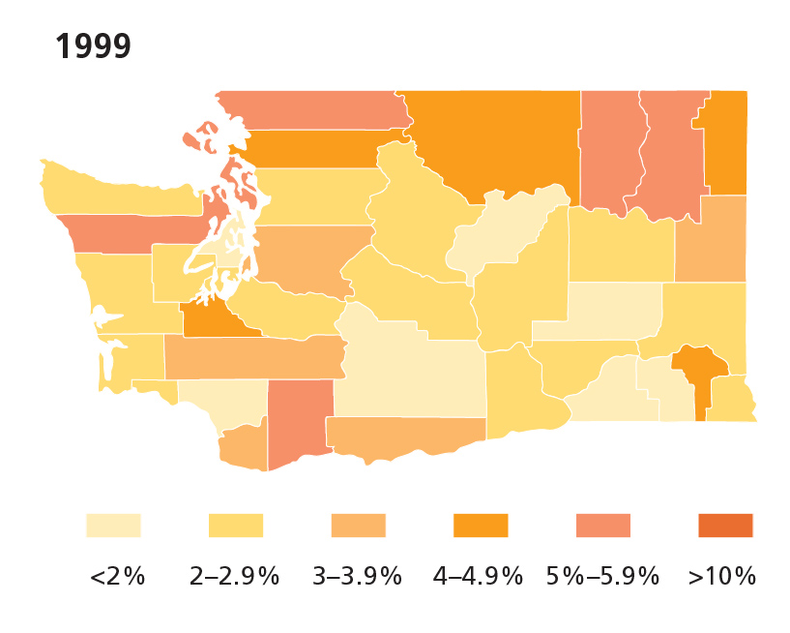
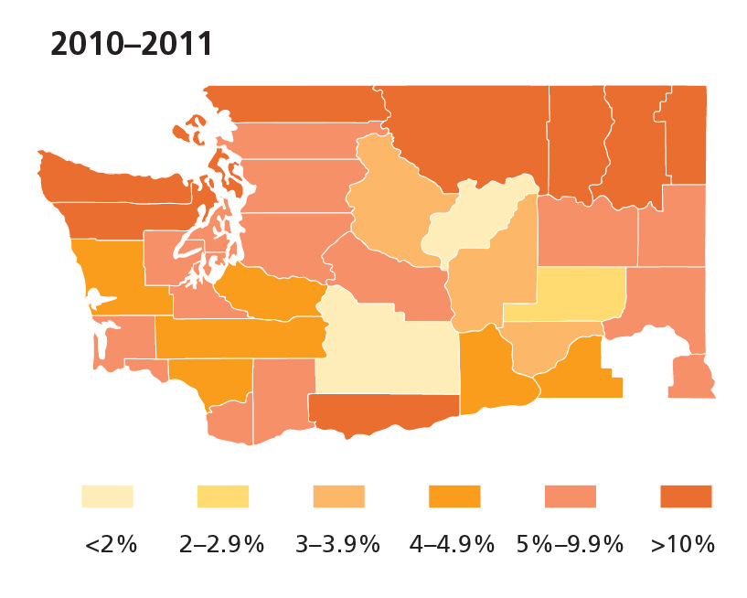
School Entry Exemptions Rose from 1999 to 2011
Source: Washington State Department of Health
Notes:
These maps show the increase in counties with school entry exemption rates from 5-10% in 1999 to over 10% in 2011.
As you can see the red areas in the past 11 years has grown considerably. Had to create a new category to show areas with over 10% exemption rates; and some schools its much higher than 10%
Our community immunity is waning.
Two counties on 2011 map that are white – Columbia and Garfield; unreported Data!

Slide 6
Vaccines Protect Against 14 Diseases!
Vaccines allow kids to keep playing and learning rather than staying home sick.
It's hard to see the benefits of vaccines because, when vaccines work, we don’t see anything dramatic.
It's true we don't see many of these diseases, but it doesn't mean they are gone. If we stop vaccinating, diseases will come back.
2012: 4,918 cases of whooping cough reported in WA state and 48,277 in the U.S. There were 20 related deaths.
2013: 11 outbreaks and 159 cases of measles were reported and 28,639 cases of whooping cough in the U.S.
2014: 23 outbreaks and 592 cases of measles across 21 states, the highest number of cases since measles elimination was documented in the U.S. in 2000. 32,971 cases of whooping cough were reported; 601 cases in WA.
2015: So far 5 outbreaks and 188 cases of measles across 24 states and the first death of measles in the U.S. in 12 years in Clallam county. 1,214 cases of whooping cough reported statewide.
Notes:
Vaccines allow kids to keep playing and learning rather than staying home sick. In the Immunity Community, it's hard to see the benefits of vaccines because, when vaccines work, we don’t see anything dramatic. Kids and communities simply stay healthy.
Our current vaccine schedule protects kids against 14 diseases! These diseases are nasty too. They can cause kids to be sick for days, hospitalized, afflicted with lifelong disabilities, and in some cases, to die. Vaccines protect against these diseases.
It's true we don't see many of these diseases, but it doesn't mean they are gone. It is because of vaccines that we have seen a decrease in these diseases in the U.S. When vaccination rates decrease, diseases can become more common in our communities. We had major measles and whooping cough (pertussis) outbreaks in the U.S. in 2012 - 2015.
2012: 4,918 cases of whooping cough reported in WA state and 48,277 in the U.S. There were 20 related deaths.
2013: 11 outbreaks and 159 cases of measles have been reported and 16,138 cases of whooping cough in the U.S.
2014: 23 outbreaks and 592 cases of measles across 21 states, the highest number of cases since measles elimination was document in the U.S. in 2000
2015: so far 5 outbreaks and 188 cases of measles across 24 states and the first death of measles in the U.S. in 12 years in Clallam county. 1,214 cases of whooping cough reported statewide.
http://www.cdc.gov/measles/cases-outbreaks.html

Slide 7
Why Do We Vaccinate?
Stop the Spread of Disease
Build Community Immunity
Protect People Too Sick to Vaccinate
Protect People Too Young or Too Old to Vaccinate
Protect Those Not Fully Immunized & Those Who Do Not Get Full Protection from Vaccination
Strengthen the Body’s Natural Immunity
Notes:
To Stop the Spread of Disease: A vaccine protects the child and also decreases the spread of that disease to others.
To Build Community Immunity: By vaccinating most people, we can protect our entire community from diseases. If enough people choose not to vaccinate, it leaves an opening for disease to break through and spread. It’s important for everyone to take part in protecting the members of our community.
To Protect People Too Sick to Vaccinate: Some kids can never get vaccinated. Children with illnesses like leukemia, other cancers, heart problems, or even some kids with asthma are too sick to get vaccinations. Some teens, adults, and elderly can also be too sick to get protection with vaccination.
To Protect People Too Young or Too Old to Vaccinate: Some vaccines can’t be given to babies or the elderly because of their age, leaving them defenseless to those diseases. By vaccinating children on time, we build a community of immunity around babies and grandparents so they have a fighting chance.
To Protect Those Not Fully Immunized & Those Who Do Not Get Full Protection: No vaccine is 100% effective. Some people don’t respond fully to a vaccine, or its protection has worn off and they need a booster shot. When most of us get vaccinated, we increase the protection for all.
To Strengthen the Body’s Natural Immunity: The immunity gained from vaccination is similar to a natural infection without the risk of a natural disease. In fact, studies show that vaccinated children suffer fewer infections overall than unvaccinated children. Washington State Department of Health Immunization Program CHILD Profile. Plain Talk About Childhood Immunization. 19. Last revised January 25, 2009. here.doh.wa.gov/materials/plain-talk-about-childhood-immunizations.

Slide 8
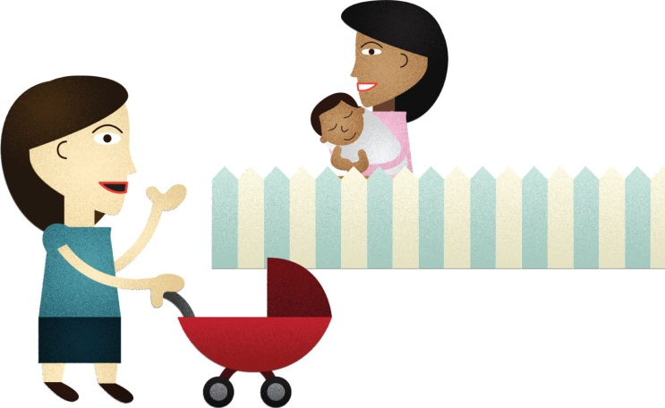
Don’t Forget About Your Vaccines
Many adults don’t realize that they also need to get vaccinated to prevent disease
Adults need an annual flu vaccination as well as a one-time Tdap booster to protect against whooping cough (pertussis)
Check with your doctor to make sure you have all the vaccines you need to stay healthy for your family!
Notes:
Don’t forget about your own vaccines! Many adults don’t realize that they also need to get vaccinated to prevent disease. Adults need an annual flu vaccination as well as a Tdap booster to protect against whooping cough (pertussis). Check with your doctor to make sure you have all the vaccines you need to stay healthy for your family!

Slide 9
Learn More
Washington Resources
Vax Northwest: vaxnorthwest.org
Washington State Department of Health: doh.wa.gov/immunization
WithinReach Immunization Program: withinreachwa.org/immunizations
School Digger: schooldigger.com/WAImmunization
National Resources
CDC Vaccines: cdc.gov/vaccines
The American Academy of Pediatrics: healthychildren.org/english/safety-prevention/immunizations
Children’s Hospital of Philadelphia: chop.edu/centers-programs/vaccine-education-center/about
Notes:
We welcome you to check out these resources for more information about vaccines.

Slide 10
Discussion
www.vaxnorthwest.org
Notes:
I’m happy to answer as many questions as I can. I am just a parent who cares about vaccines, so I might not be able to answer all of them. There are many questions that need to be answered by your child’s doctor.
So what do you think about vaccines in our community? Do any of you know a child who has had pertussis?

